Slide 1


Titolo presentazione sottotitolo
Online Learning Applications
Pricing and Advertising
A.Y. 2022-2023
Milano, XX mese 20XX
Professors Castiglioni Matteo, Gatti Nicola, Bernasconi de Luca Martino

Slide 2

Titolo presentazione sottotitolo
Pertino Paolo
Pesce Leonardo
Sandri Alberto
Simionato Enrico
Vitali Michael
10729600
10659489
10698469
10698193
10730463
Milano, XX mese 20XX
Professors Castiglioni Matteo, Gatti Nicola, Bernasconi de Luca Martino

Slide 3
Roadmap
Introduction
Advertising
Context generation
Frequent changes
0
1
2
3
4
5
6
Pricing
Joint Pricing and Advertising
Non-stationary
environment

Slide 4
Roadmap
Introduction
Advertising
Context generation
Frequent changes
0
1
2
3
4
5
6
Pricing
Joint Pricing and Advertising
Non-stationary
environment

Slide 5


Step 0: Motivations and environment design
Introducing iPear: e-commerce smartphone debut
iPear, a burgeoning e-commerce company, is ready to make waves with the launch of its very first smartphone. With a strong focus on technology and innovation, iPear aims to redefine the smartphone market.
iPear's debut smartphone promises to be a game-changer, merging technology, innovation, and user-centric design.
Its journey is one worth following closely, showcasing the transformative potential of AI in the world of e-commerce and consumer electronics.
iPear team is strictly controlling both the pricing and advertising strategies for the upcoming year (365 days) after the launch of their brand new smartphone: iPear ArmOptima.
The company is strategically positioning its smartphone in the middle-level market segment, aiming to strike a balance between affordability and advanced features to cater to a wide range of consumers. In fact, the pricing schema defined, ranges from 500€ to 700€ with equal spacing of 50€.

Slide 6



Step 0: Motivations and environment design
iPear - Introduction
The research team of the company is looking forward to launch an advertising campaign and has determined to categorize users into three distinct classes (C1, C2, C3) that differ in terms of both click frequency and cumulative daily costs as the bid varies.
In its first version, the advertising platform is able to characterize users by exploiting two binary features F1 and F2. F1 represents the age of the user, i.e. it explains whether the consumer is old (value 1) or young (value 0). F2, instead, indicates whether the customer has recently looked for a technology-related item on his/her browser (value 1) or not (value 0).
Young
Technology interested
Young
Technology Indifferent
C1
C3
Young
Technology interested
Young
Technology Indifferent
Old
Technology Interested
Old
Technology Indifferent
C2
Old
Technology Interested
Old
Technology Indifferent

Slide 7


Step 0: Motivations and environment design
iPear - Users' classes - C1: Young Technology Enthusiasts
Users of class C1, primarily comprising younger individuals with great interest in technology, are expected to possess relatively moderate purchasing power. They are likely to allocate a significant portion of their income or savings toward the latest tech products and innovations, making them an attractive target for tech-related advertising campaigns.
Moreover, being digitally passionate individuals, they are more likely to click on ads related to tech products that align with their interests and preferences. Therefore, when targeting Class C1, one can expect a relatively higher click-through rate compared to other user segments.
C1
C3
Young
Technology interested
Young
Technology Indifferent
C2
Old
Technology Interested
Old
Technology Indifferent
With that being said, the conversion rate of this class peaks at 600€, while the number of clicks is expected to be the highest and to saturate at around 100 clicks. Since the number of clicks is the highest, the highest effort in terms of cumulative daily cost is made.

Slide 8

Step 0: Motivations and environment design
iPear - Users' classes - C2: Old Technology Enthusiasts
C2 users, who fall into the older age group and share an enthusiasm for technology, typically exhibit stable and higher purchasing power with respect to other classes. They are generally more discerning consumers who prioritize quality and reliability in their tech purchases.
Customers of this class may click on tech-related ads that align with their interests and preferences. However, the number of clicks from Class C2 users is generally moderate, and usually smaller compared to the young more tech-oriented individuals.
C1
C3
Young
Technology interested
Young
Technology Indifferent
Their conversion rate peaks at 700€, while maintaining a quite high number of clicks as the bid varies; value that saturates at around 90 clicks.
The research team thinks that it is still worthy investing in reaching Class C2 due to their high purchasing power and the potential for meaningful engagement.
C2
Old
Technology Interested
Old
Technology Indifferent

Slide 9
Step 0: Motivations and environment design
iPear - Users' classes - C3: Technology Apathetic
Class C3 represents a group of individuals composed both by young and old people who generally do not exhibit a particular interest in technology.
Their click-through rate tends to be more conservative compared to tech enthusiasts. These users are less likely to actively engage with online advertisements related to technology products or services and thus little effort and few resources are allocated to this class.
C1
C3
Young
Technology interested
Young
Technology Indifferent
C2
Old
Technology Interested
Old
Technology Indifferent
Their conversion rate peaks at 500€, and their clicks curve saturate at around 70 clicks.

Slide 10
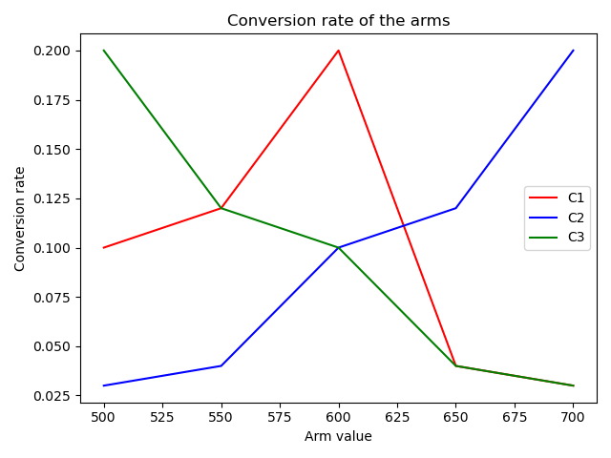
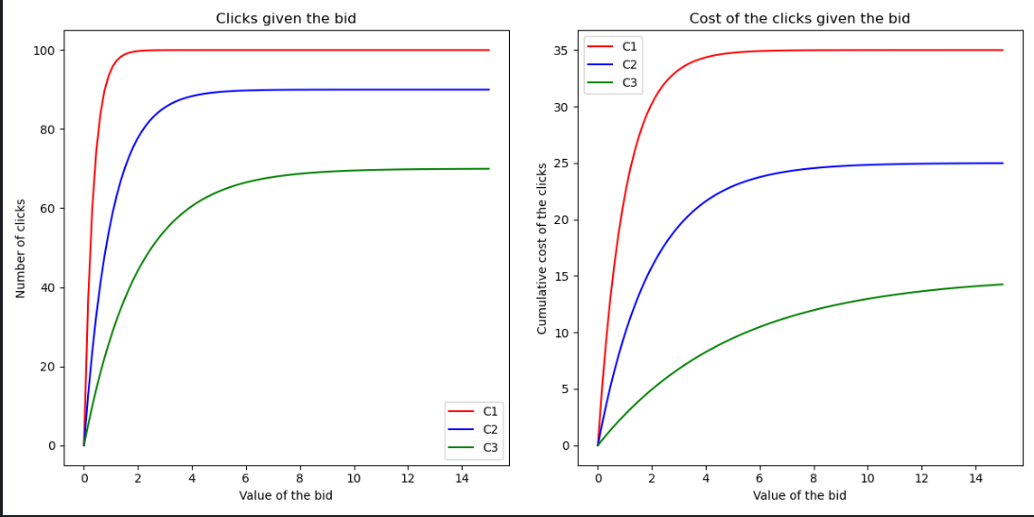
Step 0: Motivations and environment design
iPear - Users' classes - Technicalities
[A1] Conversion probabilities for the three classes
[A2] Clicks and cumulative daily costs curves

Slide 11
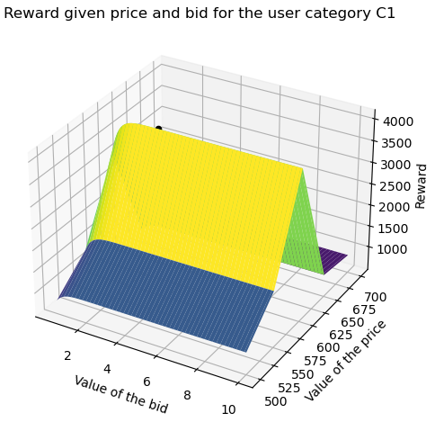
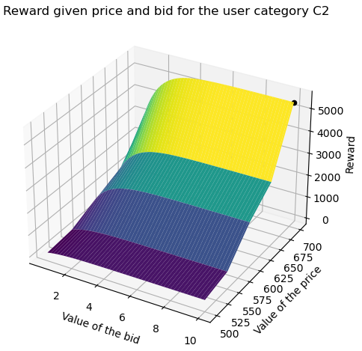
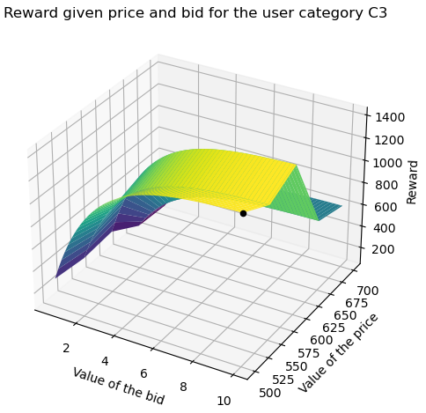
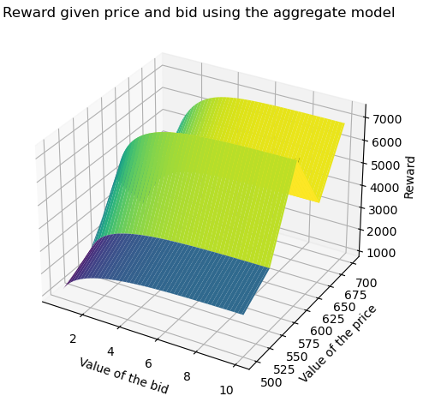
Step 0: Motivations and environment design
iPear - Users' classes - Technicalities cont.

Slide 12
Step 0: Motivations and environment design
iPear - Clairvoyant
The research team is testing the advertising platform, in the simulation described, by comparing its results in terms of reward/regret against the performances given by a clairvoyant algorithm, i.e. a perfect machine with comprehensive knowledge about both the pricing and advertising curves.
Due to its unmatched knowledge, the Clairvoyant always plays the best possible price and bid, thus it always maximize perfectly the reward (profit), which is given by:
conversion_times_margin
This algorithm works as follows:
Input: category
best_price, conversion_times_margin ← maximization of reward from price given category
best_bid, reward ← maximization of reward from bid given category and conversion_times_margin
Output: best_price, best_bid, reward

Slide 13
Step 0: Motivations and environment design
iPear - Users' classes - Clairvoyant cont.
Input: category
best_price, conversion_times_margin ← maximization of reward from price given category
best_bid, reward ← maximization of reward from bid given category and conversion_times_margin
Output: best_price, best_bid, reward
1.
Exhaustive search over the list of prices that returns the price which maximize the
conversion probability * (price - other costs)
quantity (note that the conversion probability is known since the clairvoyant is omniscient, thus it knows the pricing curves and the environment parameters).
2.
Exhaustive search over the list of bids that returns the bid which maximize the
#_{clicks} * conversion_times_margin - cumulative daily costs quantity (note that the #_{clicks} and the cumulative daily costs are known since the clairvoyant is omniscient, thus it knows the advertising curves).

Slide 14
Roadmap
Introduction
Advertising
Context generation
Frequent changes
0
1
2
3
4
5
6
Pricing
Joint Pricing and Advertising
Non-stationary
environment

Slide 15

Step 1: Learning for pricing
Setting
In this step the pricing setting is unknown, instead the advertising one is known. The objective is to maximize the reward while estimating the purchase conversation rates.
Scenario:
All the users belong to class C1
Curves related to the advertising part are known
Curve related to the pricing part is unknown
Task:
Apply UCB1 and TS to tackle the problem
Plot the average value and standard deviation of the cumulative regret, cumulative reward, instantaneous regret and instantaneous reward

Slide 16
Step 1: Learning for pricing
Approach
In this scenario we use TS and UCB1 to minimize the regret while estimating the conversion probabilities associated to each price, so that it is possible to understand which is the best one.
Since in the pricing setting the functions of the number of clicks and cumulative daily costs are known, it is possible to use the optimal bid given the price. At each round, for each possible price, the best bid is computed exploiting the clairvoyant and then the associated number of clicks and daily cost are calculated.
Given these data, the arm is pulled by choosing the one that maximizes the reward formula where the conversion probability is substituted by:
a sample drawn from the Beta distribution for TS
the upper confidence bound for UCB1
Successively, each learner is updated using the data collected, namely the total reward for the day and for each user the interaction with the website, that is a 1 if there is a purchase, otherwise 0.

Slide 17
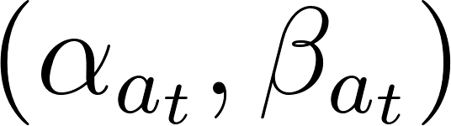
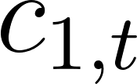
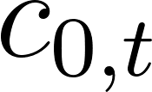
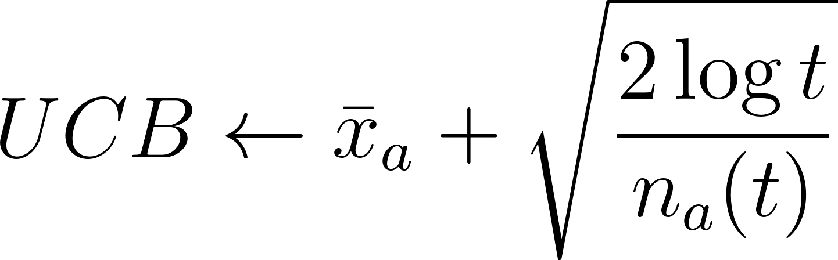
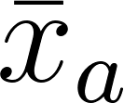
Step 1: Learning for pricing
Approach
The updates for the learners are:
TS:
where:
are the beta parameters for arm a at time t;
is the number of conversions at time t;
is the number of people who click but don’t purchase at time t.
UCB:
where:
is the estimate of the conversion probability and it is given by the total number of conversions for arm a until this point divided by the total number of observations for the arm a;
is the total number of clicks collected by arm a until time t.

Slide 18
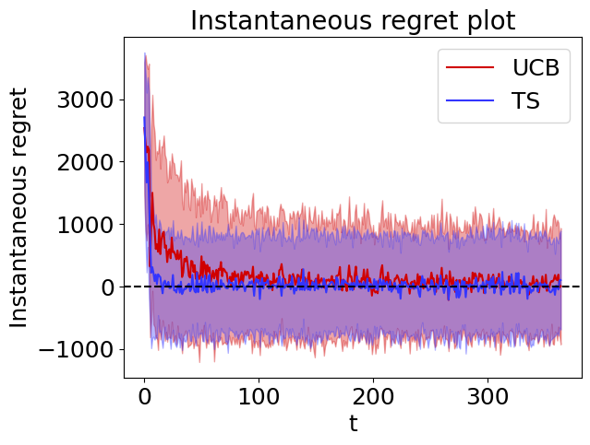
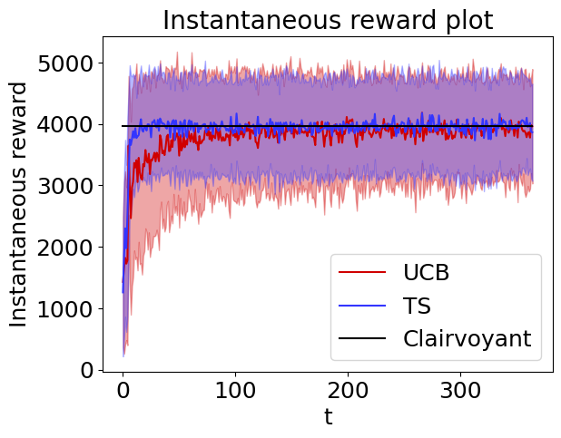
Step 1: Learning for pricing
Results
The following plots are obtained by launching 100 experiments.
In this case TS performs much better since in few days understands which one is the best arm.
It pulls the best arm the majority of the time because it tries all the arms in the initial days and can estimate the conversion probability well as it receives roughly 100 samples for the pulled arm in a single day. The conversion probability is also well estimated by UCB, but it more frequently plays sub-optimal arms during the first rounds when the upper bounds are larger.

Slide 19
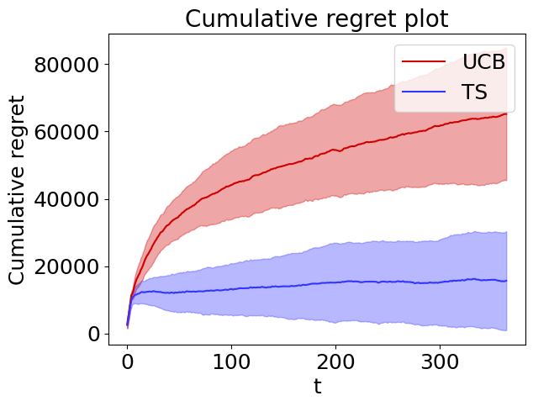
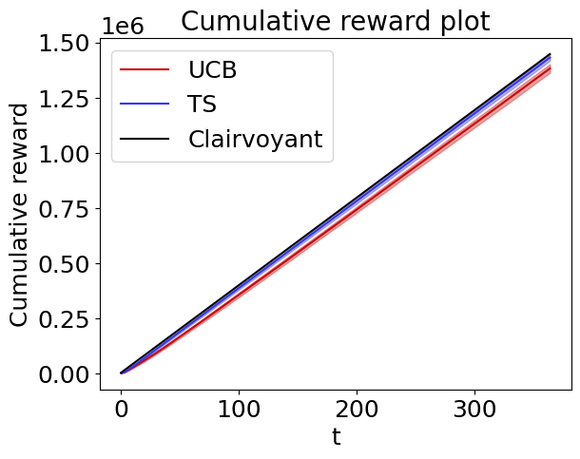
Step 1: Learning for pricing
Results
It is clear that both the learners achieve a sub-linear cumulative regret as expected from their theoretic bounds. In this case TS performs much better since in few days understands which one is the best arm.
It is possible to observe that the cumulative regret of UCB is around 4 times higher than the one obtained by TS.

Slide 20
Roadmap
Introduction
Advertising
Context generation
Frequent changes
0
1
2
3
4
5
6
Pricing
Joint Pricing and Advertising
Non-stationary
environment

Slide 21

Step 2: Learning for advertising
Setting
In this step the advertising setting is unknown, instead the pricing one is known. The objective is to maximize the reward while estimating the number of clicks and cumulative daily costs.
Scenario:
all the users belong to the class C1
the curve related to the pricing problem is known
the curves related to the advertising problem are not known
Task:
application of GP-UCB1 algorithm and GP-TS algorithm to maximize the reward while estimating the clicks and cumulative cost curves of the advertising problem
plot the average value and standard deviation, over a sufficiently large number of runs, of the cumulative regret, cumulative reward, instantaneous regret and instantaneous reward

Slide 22
Step 2: Learning for advertising
Assumptions
In the advertising setting, the pricing curve is fully known, thus the price is considered to be fixed and set to be the best one in terms of conversion rate times margin.
In this context, the aim is maximize the reward while giving an estimate of two curves which respectively describe the number of clicks and the cumulative costs as the bid varies.
To give these estimates we used Gaussian Processes (GP), because they allow to tackle the regression problem with mild assumptions on the function to estimate and, most importantly, because they also return, together with the average value learnt from observations, a measure of the uncertainty of the result of the regression, i.e. the output is a probability distribution over the outcome.
This fact is crucial to assure the convergence of bandit algorithms.
Since estimating the clicks and cumulative costs curves for every possible bid might take too long time, we assume that there is correlation between arms (i.e. values of the bids) that are close each other. This requires the two curves to be sufficiently smooth.

Slide 23
Step 2: Learning for advertising
Component structure
GP-Learner
The general structure of our learners based on Gaussian processes is the following:
a gaussian process is used to model the number of clicks given the bids, so provided the observations it gives the mean value of the function describing the clicks and a measure of the uncertainty of its estimate
another gaussian process is deployed to model the cumulative daily costs curve given the bids
a module is dedicated to the update of the GP parameters whenever a new observation is available.
to pull an arm (i.e. choose a bid), the reward
is maximized and the corresponding bid is taken.
Gaussian Process Clicks
Gaussian Process Costs
Model update
Arm puller with reward maximization

Slide 24




Step 2: Learning for advertising
Component structure - GP-UCB1
A Gaussian Process is used, given the observations, to estimate the mean value of the clicks curve together with a measure of the uncertainty it has in doing so. Another GP, on the other hand, does the same for the cumulative daily cost curve.
GP-UCB
Gaussian Process Clicks
Constant Kernel * RBF Kernel + WhiteKernel
means_clicks
sigmas_clicks
Whenever a new sample is obtained, the gaussian processes are updated (i.e. it is trained with the past samples and the new one), the ^{[1]} parameter is calculated and finally the confidence interval, which is given by
Gaussian Process Costs
Constant Kernel * RBF Kernel + WhiteKernel
means_costs
sigmas_costs
Model update
Once-per-day an arm (i.e. a bid) is pulled. The upper confidence bound of the clicks and the lower confidence bound for the costs is calculated, in order to finally calculate and maximize the reward, and play the corresponding bid.
Arm puller
[1] Gaussian Process Optimization in the Bandit Setting: No Regret and Experimental Design, Srinivas et al. (2010), https://arxiv.org/pdf/0912.3995.pdf

Slide 25
Step 2: Learning for advertising
Component structure - GP-TS
A Gaussian Process is used, given the observations, to estimate the mean value of the clicks curve together with a measure of the uncertainty it has in doing so. Another GP, on the other hand, does the same for the cumulative daily cost curve.
GP-TS
Gaussian Process Clicks
Constant Kernel * RBF Kernel + WhiteKernel
means_clicks
sigmas_clicks
Whenever a new sample is obtained, the gaussian processes are updated (i.e. they are trained with the past samples and the new one).
Gaussian Process Costs
Constant Kernel * RBF Kernel + WhiteKernel
means_costs
sigmas_costs
Model update
Once-per-day an arm (i.e. a bid) is pulled. In the case of Thompson Sampling the number of clicks and the cumulative daily cost to use to calculate the reward are drawn from a Gaussian Distribution whose mean and standard deviation parameters are the ones estimated by the GPs.
Arm puller

Slide 26
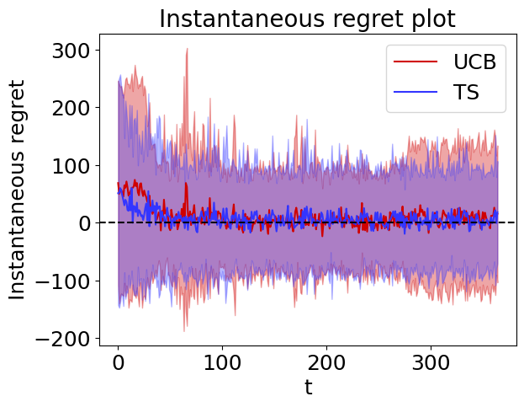
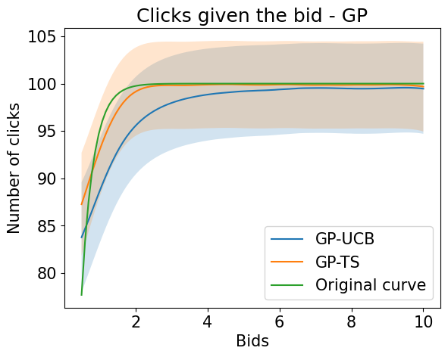
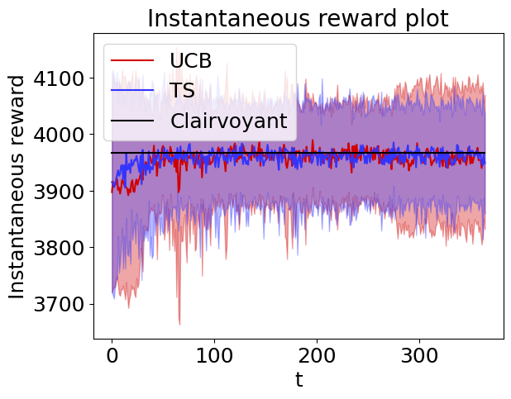
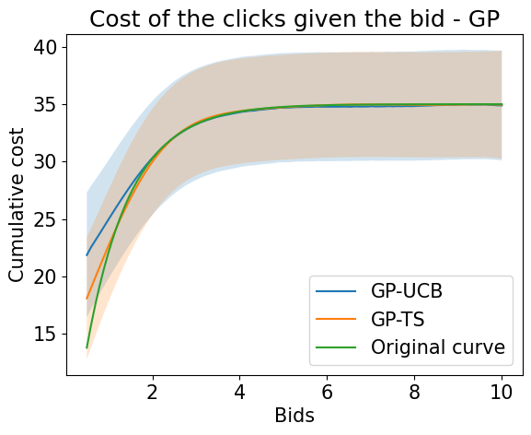
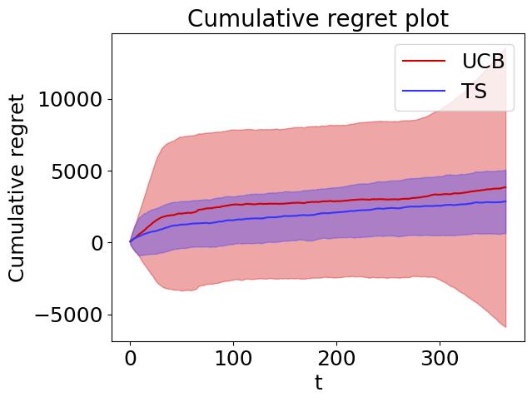
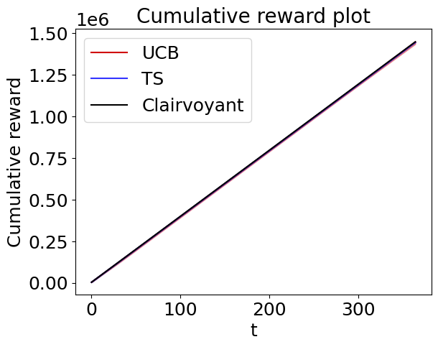
Step 2: Learning for advertising
Results
We ran 100 experiments with a time interval of an year each.
As we can see both the clicks and the cumulative daily costs curves have been approximated quite well by the Gaussian Processes of the learners.
Here the plots of the instantaneous reward/regret and the cumulative reward/regret of both the algorithms used.

Slide 27
Step 2: Learning for advertising
Results
As we can see from the previous plots, both algorithms exhibit sub-linear regret, in alignment with their theoretical guarantees, and they achieve this with a notable speed of convergence.
Also in this step, Thompson Sampling is outperforming UCB1 in terms of regret minimization; nevertheless they both approach the best solution for the problem.
It is worth noticing that both algorithms achieve great results quite fastly. This can be attributed to the deliberate design of the clicks and cumulative daily costs curves, where a significant portion of the bids have similar values in terms of these quantities. As a result, with a fixed and predetermined price, both algorithms converge to arms in the neighbourhood of the optimal one after a relatively small number of learning iterations.

Slide 28
Roadmap
Introduction
Advertising
Context generation
Frequent changes
0
1
2
3
4
5
6
Pricing
Joint Pricing and Advertising
Non-stationary
environment

Slide 29
Step 3: Learning for joint pricing and advertising
Setting
The pricing and advertising settings are both unknown. The objective is to maximize the reward while estimating the purchase conversion rates, the number of clicks and cost. It is possible to obtain an optimal solution of the problem since we solve it in joint way.
Scenario:
Users belong to a single class C1
Curves related to the advertising problem are unknown
Curve related to the pricing problem is unknown
Task:
Apply UCB1 and TS to maximize the reward while estimating the conversion probabilities
Apply GP-UCB1 and GP-TS to maximize the reward while estimating the advertising curves
Plot the average value and standard deviation of the cumulative regret, cumulative reward, instantaneous regret and instantaneous reward

Slide 30
Step 3: Learning for joint pricing and advertising
Approach
The approach adopted in this point exploits the methods used in the previous two steps.
The learners, in this setting, are composed by two parts: one for solving the pricing problem and one for solving the advertising one. Both learners are used to interact with the environment trying to maximize the collected reward.
The TS learner is composed by a TS learner for the pricing problem and a GP-TS learner for the advertising problem.
The UCB1 learner is composed by a UCB1 learner for the pricing problem and a GP-UCB1 learner for the advertising problem.
Approach:
the learner chooses the best price and the best bid that maximize the reward;
the learner plays the chosen price and bid in the environment;
the learner updates its models associated to the pricing and to the advertising setting using respectively the obtained conversions and number of clicks and cumulative daily cost.

Slide 31
Step 3: Learning for joint pricing and advertising
Approach
Schema of the system
System
Learner for the advertising problem
Learner for the pricing problem
Pulled price
Environment
Pulled bid
Observed conversions
Observed number of clicks and cumulative daily cost

Slide 32
Step 3: Learning for joint pricing and advertising
Approach
The learner performs the maximization of the reward by jointly optimizing prices and bids.
Steps of the optimization:
the system uses the learner of the pricing problem to compute an estimate of the conversion probabilities for all the prices. The way the estimate is done depends on the algorithm used. In the case of UCB1, the value is the upper confidence bound; in the case of TS, the value is given by sampling the Beta distributions;
the system then uses the learner of the advertising problem to compute an estimate of the number of clicks and of the cumulative daily costs for all the bids. Also in this case the estimate depends on the algorithm used. In the case of UCB1, the value is the upper confidence bound of the number of clicks and lower confidence bound of the costs and, in the case of TS, the value is given by sampling the distributions of the clicks and of the costs;
using the obtained values, the learner computes the estimates of the reward for all the couples price-bid using the formula explained in the step 0;
the pulled price and bid are the ones that maximize the reward. Then they are played in the environment.

Slide 33
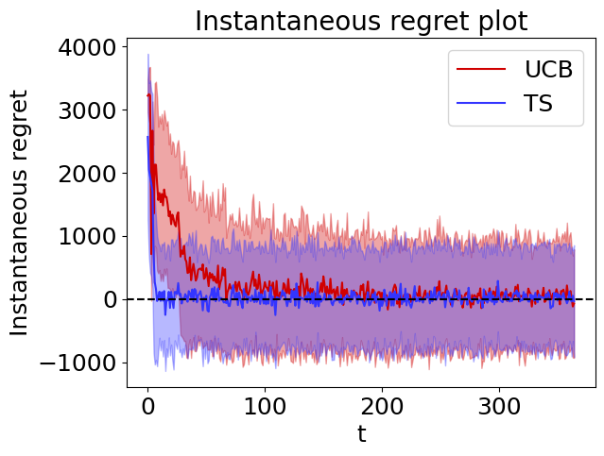
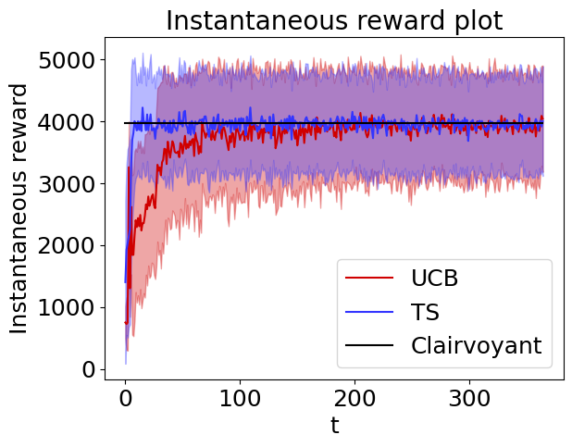
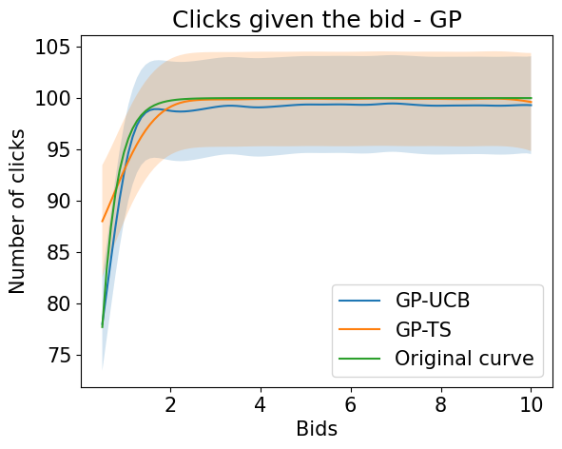
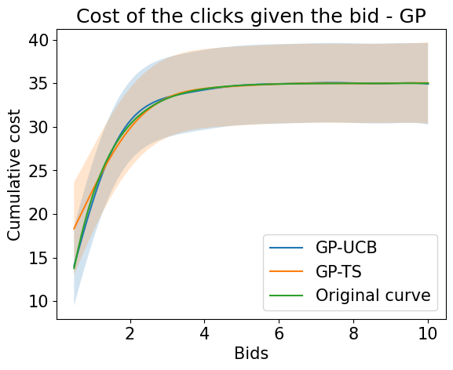
Step 3: Learning for joint pricing and advertising
Results
The following plots are obtained by averaging the results of 100 experiments.
The instantaneous regret tends to zero for both the algorithm as the time grows, they are learning the best prices and bids to use in the environment. The instantaneous regret is a little higher than the ones of the first two steps of the project since the learner has to deal with more uncertainty, it doesn’t know both the optimal price and the optimal bid.
The TS algorithm is faster in learning the best arms with respect to UCB1, in a very small amount of days it achieves almost zero instantaneous regret and so the optimal instantaneous reward.
Also in this case the clicks and the cumulative daily costs curves have been approximated well by the Gaussian Processes of the learners.

Slide 34
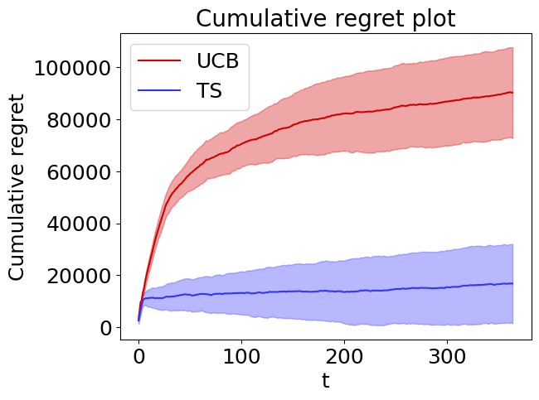
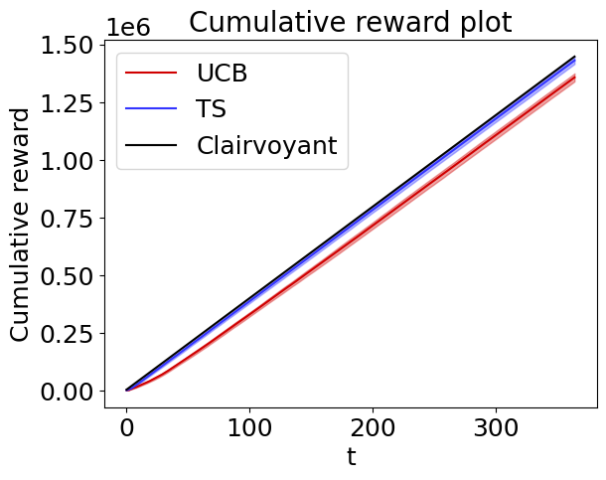
Step 3: Learning for joint pricing and advertising
Results
The cumulative regret plot shows that the algorithms meet their theoretical bounds since they have a sub-linear cumulative regret. It is possible to see that the cumulative regret of the algorithm is higher than the ones of the first two steps because the problem is more complex that the ones addressed by them. Still the plots are similar to the ones of the step 1 since the variable that makes the most of the difference in determining the value of the reward is the price.
The quicker learning of TS is even more visible in the cumulative regret plot. The performance of TS are higher, it achieves a regret that is more than 4 times lower than the one of the UCB1 algorithm.

Slide 35
Roadmap
Introduction
Advertising
Context generation
Frequent changes
0
1
2
3
4
5
6
Pricing
Joint Pricing and Advertising
Non-stationary
environment

Slide 36
Step 4: Context generation
Setting
In the setting of this step, and very often in real scenarios, users have different characteristics.
Users interact with the e-commerce website in a variety of ways, which includes being more inclined to purchase the product at a different price and being more or less influenced by advertising campaigns.
Considering this scenario and based on the characteristic of the users it is usually possible to identify a set of classes within which users have the same features.
From a mathematical point of view each class can have a different demand curve and different functions of the clicks and the costs.
There are two way to tackle the problem:
considering an aggregated model: the e-commerce optimizes prices and bids considering the data as generated by a single class reaching sub-optimal results, in general;
considering a disaggregated model: the e-commerce optimizes prices and bids considering the data as generated by a many classes reaching better results with respect to the previous case.
In this step the performance of different settings and approaches will be evaluated and compared.

Slide 37

Step 4: Context generation
Setting - Case 1
In this part of the step the context structure is known. The pricing and advertising settings are unknown. The objective is to maximize the reward while estimating the purchase conversation rates, the number of clicks and cost. It is possible to obtain an optimal solution of the problem since we solve it in a disaggregate way.
Scenario:
Users belong to three classes: C1, C2, C3
Users are characterized in terms of 2 binary features
The context structure is known beforehand
Curves related to the advertising problem are unknown
Curve related to the pricing problem is unknown
Task:
Apply UCB1 and TS to maximize the reward while estimating the conversion probabilities for each class separately
Apply GP-UCB1 and GP-TS to maximize the reward while estimating the conversion probabilities for each class separately
Plot the average value and standard deviation of the cumulative regret, cumulative reward, instantaneous regret and instantaneous reward

Slide 38
Step 4: Context generation
Approach - Case 1
In the case the actual context structure is known, it is possible to create a learner for each context in order to separately learn the curves of the different classes present in the environment.
Each learner interacts with the environment trying to maximize its reward. The approach adopted by each regret minimizer is the same explained in the step 3.
Approach:
the learner chooses the best price and the best bid that maximizes the reward;
the learner plays the chosen price and bid in the environment;
the learner updates its models associated to the pricing and to the advertising setting using respectively the obtained conversions and number of clicks and cumulative daily cost.

Slide 39

Step 4: Context generation
Approach - Case 1
System
Environment
Pulled arms (price and bid)
Observation of the class
Pulled arms (price and bid)
Observation of the class
Pulled arms (price and bid)
Observation of the class

Slide 40
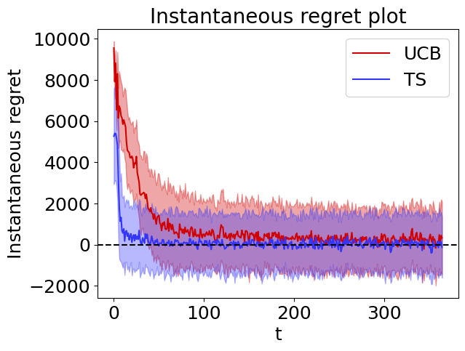
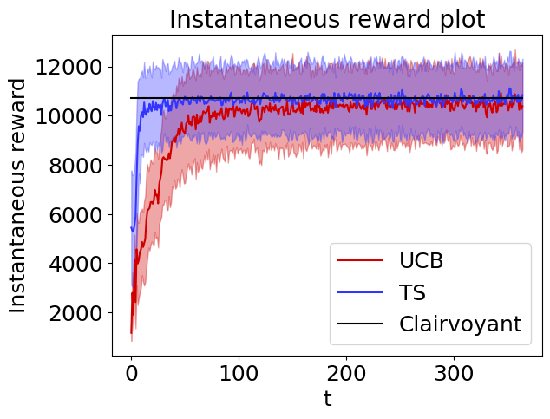
Step 4: Context generation
Results - Case 1
The following plots are obtained by averaging the results of 100 experiments.
The instantaneous regret tends to zero for both the algorithm as the time grows, they are learning the best arms. The initial instantaneous regret is higher than the ones of the previous steps since it is the sum of the instantaneous regret of three learners, one for each class of users. It is possible to see that also the instantaneous reward is higher than the ones of the previous cases because it is the sum of the rewards given by the three classes.
The TS algorithm is faster in learning the best arms with respect to UCB1, in a very small amount of days it achieves almost zero regret and so the optimal instantaneous reward.

Slide 41
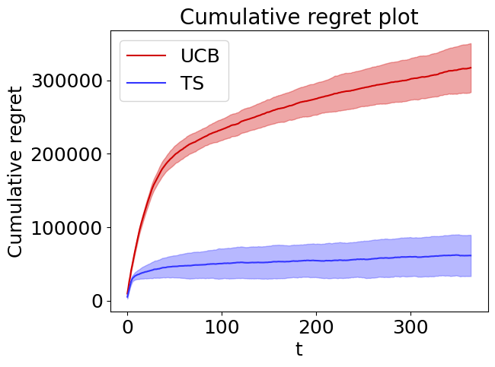
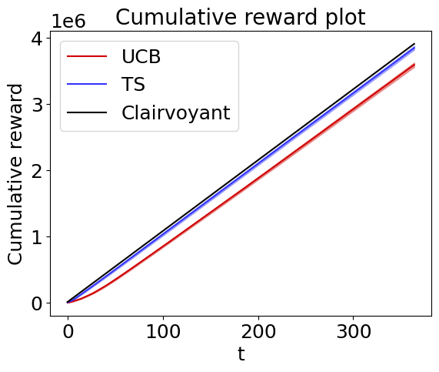
Step 4: Context generation
Results - Case 1
The cumulative regret plot shows that the algorithms meet their theoretical bounds since they have a sub-linear cumulative regret.
The TS algorithm achieves a cumulative regret that is much lower than the one of UCB1 thanks to its quicker learning. TS has very good performance, after a year, it allows to have a reward of about 4 millions € and a regret of about 50 thousand €, the reward is much lower than the regret.
The cumulative reward is higher than the one of the previous cases since it comes from all the classes of users.

Slide 42
Step 4: Context generation
Setting - Case 2
In this part of the step the context structure is unknown. The pricing and advertising settings are unknown. The objective is to maximize the reward while estimating the purchase conversation rates, the number of clicks and cost. It is required to solve the problem in a disaggregate way, estimating the context structure of the environment from data.
Scenario:
Users belong to three classes: C1, C2, C3
Users are characterized in terms of 2 binary features
The context structure is unknown
Curves related to the advertising problem are unknown
Curve related to the pricing problem is unknown
Task:
Apply UCB1 and TS to maximize the reward while estimating the conversion probabilities for each class separately
Apply GP-UCB1 and GP-TS to maximize the reward while estimating the advertising curves for each class separately
Apply a context generation algorithm in order to estimate the context (every two weeks)
Plot the average value and standard deviation of the cumulative regret, cumulative reward, instantaneous regret, and instantaneous reward

Slide 43
Step 4: Context generation
Approach - Case 2
In the case the actual context structure is not known, the number of learners to instantiate and the type of users with which the learners have to interact are not known.
The context structure has to be estimated from the observations using a context generation algorithm while the learning algorithms are executing.
The underlying idea is to find groups of people, identified by specific values of the two binary features considered by the problem, that have similar pricing and advertising models and then split the groups and create a learner for each one of them.
At the beginning, there is no information about the actual context structure so the only way to go is to use a single learner that interacts with the aggregate model of the environment where users of all the types are contained.
In the setting under consideration, there are 4 possible user types based on the binary features “age” and “has searched technology terms”. The systems interact with the environment obtaining observations for each type of user and store them.

Slide 44
Step 4: Context generation
Approach - Case 2
Steps of the approach from an high level point of view
Initialize a learner that considers a single aggregate context containing all the users
Let the currently active learners interact with the environment
Apply the context generation algorithm using the collected observations
Create a new set of learners based on the new context and update them

Slide 45
Step 4: Context generation
Learners and observations - Case 2
Each learner interacts with the environment trying to maximize its reward. The approach adopted by each regret minimizer is the same explained in the step 3.
Approach:
the learner chooses the best price and the best bid that maximizes the reward;
the learner plays the chosen price and bid in the environment;
the learner updates its models associated to the pricing and to the advertising setting using respectively the obtained conversions and number of clicks and cumulative daily cost;
the observations are stored grouped by feature tuple.
Structure of an observation:
price pulled by the algorithm;
observations of the conversions obtained from the environment;
bid pulled by the algorithm;
number of clicks obtained from the environment;
cumulative daily cost obtained from the environment;
collected reward.

Slide 46
Step 4: Context generation
Greedy algorithm - Case 2
The context generation algorithm applied is a greedy algorithm that estimates the reward of a context and the sum of the rewards coming from the possible sub-context and chooses whether to split or not based on them.
The greedy algorithm builds a tree where each node represent a context. The algorithm starts from a single node, namely the root, that consists in the completely aggregate context.
The split of a node is done choosing a feature of the users and creating a node for each value that the feature can assume.
The arcs of the tree constrain the value assumed by the split feature inside the child node.
The path that brings from the root node to another node defines the values of the features that a user must have to belong to the considered node (context).
Based on the data the algorithm can choose to expand some contexts and to not expand other contexts.
Example of tree
Has searched technology terms
No
Yes
Young
Age
Old
Old
Age
Young

Slide 47
Step 4: Context generation
Implementation of the greedy algorithm - Case 2
Implementation choices:
context generation algorithm runs every 14 days (from specification);
at each run of the context generation algorithm, it starts considering a single aggregated context and applies to it the procedure just described. In this way even if the algorithm chose in the previous 14 days a wrong split, it can correct the context structure, on the basis of the observations, starting again from the beginning;
all the observations from the beginning to the current step are used by the context generation algorithm to evaluate the new context structure.

Slide 48
Step 4: Context generation
Greedy algorithm - Case 2
Steps of the greedy algorithm for context generation from a high level point of view
Consider the root of the tree
All the nodes have been expanded
Evaluate a performance measure of the considered node
Consider an unexpanded node
Evaluate a performance measure of the child nodes of the current node for all the possible splits
End
False
Compare the performance measures of the child nodes and of the current node
Split following the split condition
True
Consider a child node

Slide 49
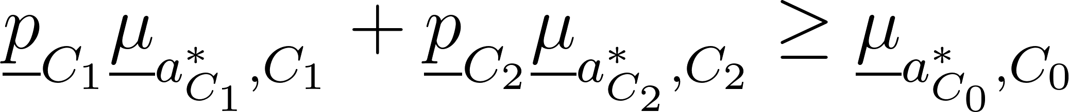
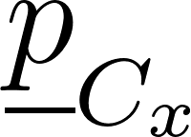
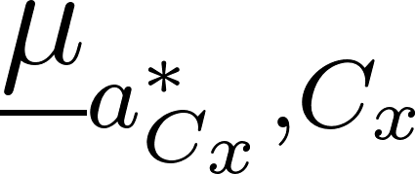
Step 4: Context generation
Split condition - Case 2
The split of a context in two sub contexts has to be done only if it is valuable in terms of reward, namely it allows to gain a bigger reward with a certain confidence.
In the case of binary features the split condition that is evaluated when splitting is:
where the quantities are:
is the lower bound of the probability of a user to belong to the context C_{x};
is the lower bound of the reward of the best arm in the context C_{x};
C₁ and C₂ are two sub-contexts generated by C₀, in other words they are the child nodes of C₀ splitting on a feature.
The algorithm is greedy, so when many features can be used to split a context, the one used provides the maximum estimated reward, namely the one for which the left-hand side of the previous inequality is bigger.

Slide 50
Step 4: Context generation
Implementation of the context generation algorithm - Case 2
Computation of the lower bound of the reward in each node
Consider the observations of the users that belongs to the context of the node to evaluate
Estimate the lower bound of the number of clicks and the upper bound of the cumulative daily costs using a Gaussian process for each one
Estimate the lower bound of the conversion probabilities for each price
Compute the estimated reward for each couple price-bid
Take the maximum of the rewards

Slide 51
Step 4: Context generation
Implementation of the context generation algorithm - Case 2
The usage of the Gaussian processes to estimate the number of clicks and the cumulative daily costs is driven by the fact that in general we could have many values of the bids for which the algorithm do not have measurements.
The Gaussian processes allow to exploit the shape of the advertising curves in order to have a good approximation of the number of clicks and costs for all the bids that can be used in the context generation algorithm. The reasoning is similar to the one adopted by the GP-TS and GP-UCB learners.
The lower bound of the number of clicks is computed as the mean of the Gaussian process of the number of clicks minus the standard deviation of the Gaussian process.
The upper bound of the cumulative daily cost is computed as the mean of the Gaussian process of the cumulative daily cost plus the standard deviation of the Gaussian process.

Slide 52
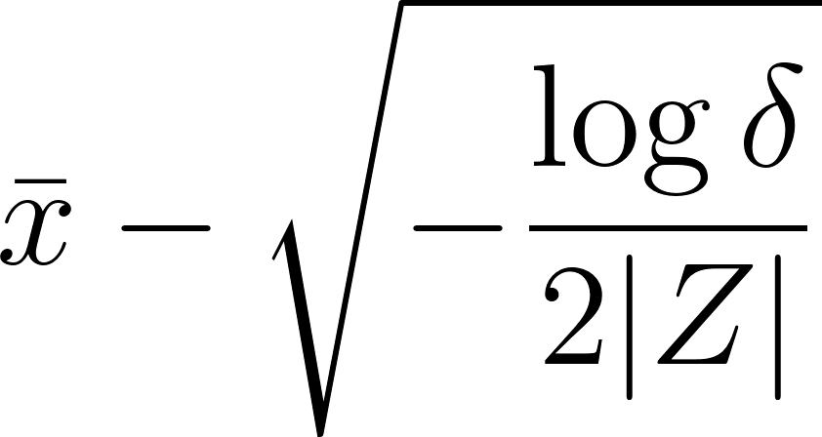



Step 4: Context generation
Lower bound - Case 2
The lower bound used for the conversion probability and for the probability of a context is the Hoeffding bound, the general formula is:
where the quantities are:
is the mean of the considered random variable;
is 1 minus the confidence, it can be considered as a metric used to control the level of certainty required for an algorithm to decide whether to split the context or not;
is the size of the considered set of data.

Slide 53

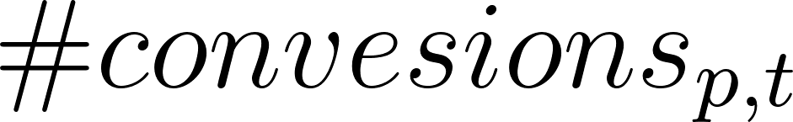
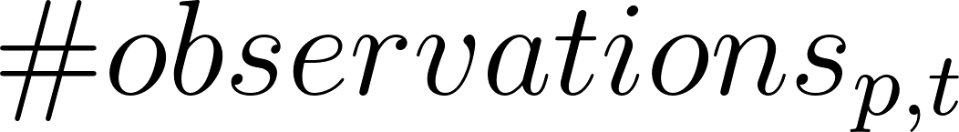
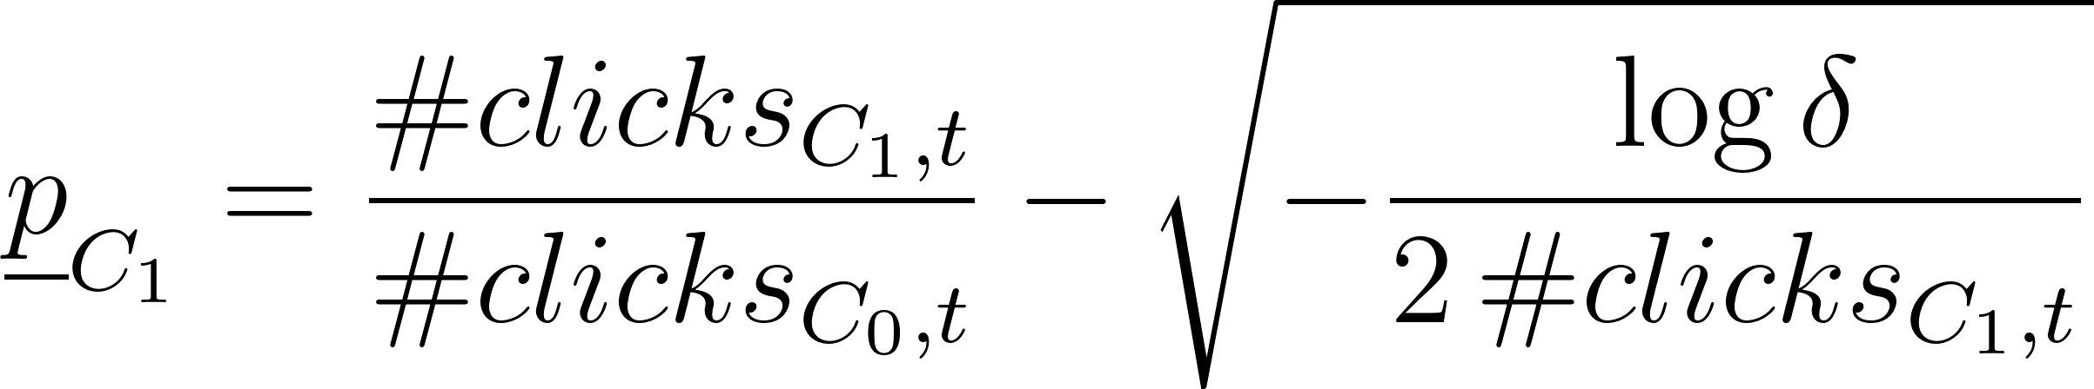
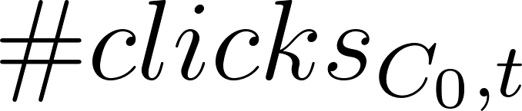
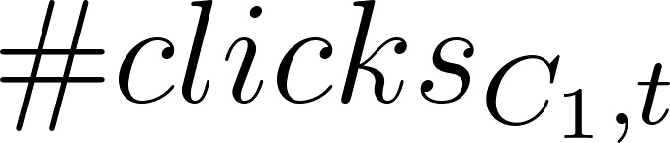
Step 4: Context generation
Lower bound - Case 2
The lower bound of the conversion probability is computed for each one of the prices p and it is:
is the number of conversions until time t of the considered price p;
is the total number of observations until time t of the considered price p.
Using the lower bound for the probability of a context, it becomes:
is the total number of clicks given by the users belonging to context C₀ until time t;
is the total number of clicks given by the users belonging to context C₁ until time t;
C₁ is a sub-context of the context C₀.

Slide 54
Step 4: Context generation
Training of the new learners - Case 2
After the new contexts have been produced by the greedy algorithm, the set of learners for the next 14 days has to be created:
if a new context is created, different from all the ones of the previous context structure, a new learner is deployed for interacting with the users of that context;
if a context remains invariant after the execution of the context generation algorithm, its learner remains the one used in the previous days. This is done for performance reasons.
New learners
Before starting the interaction with the environment, the new learners are trained using all the past observations of the users belonging to the related context.
Using all the observations allows to exploit past data and to have better performances.
In order to be efficient, the Gaussian processes of each new learner are fit only once all the past observations have been assigned to them, and not in an online fashion.

Slide 55
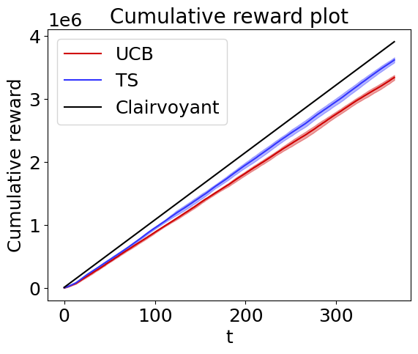
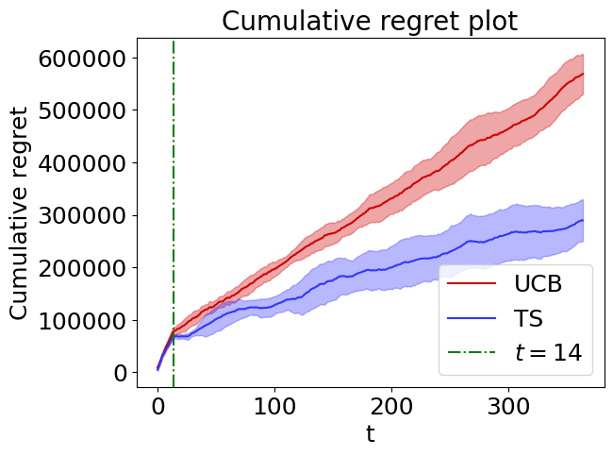
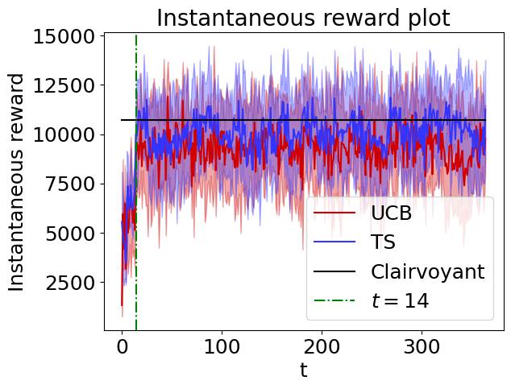
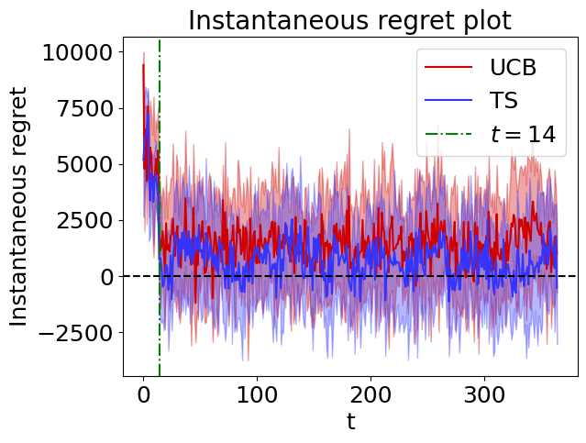
Step 4: Context generation
Results - Case 2
The following plots are obtained by averaging the results of 10 experiments.
By looking at the instantaneous reward (regret) plot we can see, during the first days of execution, the actual effect of the context generation algorithm.
At t = 14 days it starts the first execution of the aforementioned algorithm, thus leading to the separation of the aggregated context into 2 or more sub-contexts. This fact leads to a rapid growth (decrease) of the instantaneous reward (regret) which is then, more or less maintained for the remaining days of the year. However, the behaviour is not stable, but it presents a fluctuating trend in some parts of the year.
This is due to the fact that the context generation algorithm may switch, for some reasons that are due to the stochasticity of the observations and to our design of the environment, from the optimal split (3 contexts) to sub-optimal ones (e.g. 2 contexts).

Slide 56
Step 4: Context generation
Results - Case 2
It is possible to notice that Thompson Sampling seems to achieve sub-linear regret, while UCB1 shows a linear behaviour, thus leading to sub-optimality. The curves are a little bit noisy due to the low number of experiments.
Even if the regret of the UCB1 algorithm looks linear, during the execution of the context generation algorithm, it was observed that UCB1 was able to understand quite well the correct context structure.
The behaviour of UCB1 is still able to achieve a not too high regret.

Slide 57
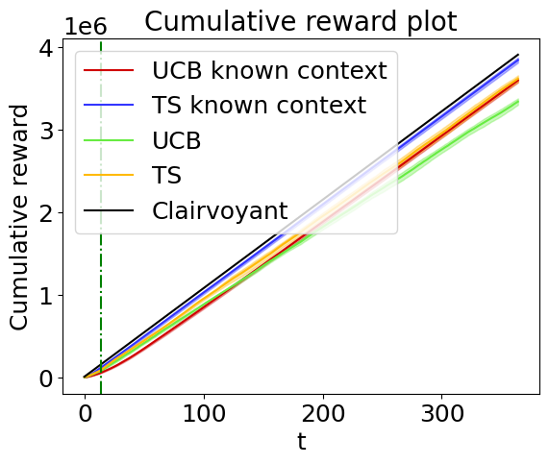
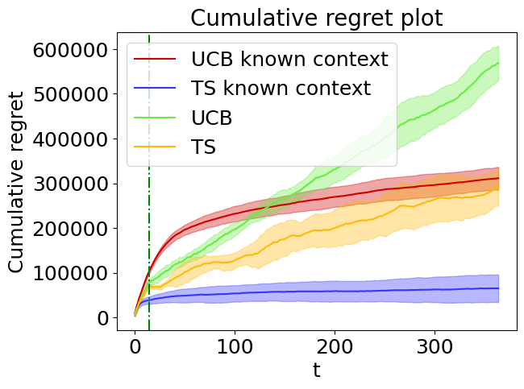
Step 4: Context generation
Comparison cases 1 and 2
Here the comparison between the learners of the scenario 1 and 2.
The learner that implements the context generation algorithm achieves good results, but obviously the learner that knows the context in advance outperforms it. This is valid for both TS and UCB. Due to the big uncertainty related to the fact that the learner in the scenario 2 does not know the context, it cannot achieve the best performance.
TS of the scenario 2 is comparable to the curve of the TS algorithm in the case of known context since it is quite sub-linear, whereas the UCB1 algorithm in the unknown context setting obtains a much higher regret in comparison to UCB1 applied knowing the context (regret is double and it will increase even more).

Slide 58
Step 4: Context generation
Setting - Case 3
In this part of the step the context structure is unknown. The pricing and advertising settings are unknown. The objective is to maximize the reward while estimating the purchase conversation rates, the number of clicks and cost. It is required to solve the problem in a aggregate way, so without estimating the context structure of the environment.
Scenario:
Users belong to three classes: C1, C2, C3
Users are characterized in terms of 2 binary features
The context structure is unknown
Curves related to the advertising problem are unknown
Curve related to the pricing problem is unknown
Task:
Apply UCB1 and TS to maximize the reward while estimating the conversion probabilities
Apply GP-UCB1 and GP-TS to maximize the reward while estimating the advertising curves
Plot the average value and standard deviation of the cumulative regret, cumulative reward, instantaneous regret and instantaneous reward

Slide 59
Step 4: Context generation
Approach - Case 3
In this case the actual context structure is not known and the choice is to not use a context generation algorithm to learn the context structure of the environment. Instead a single learner is used to tackle the problem. The learner will choose a single price and a single bid per day and will use it for all the possible types of users.
The learner interacts with the environment trying to maximize its reward. The approach adopted by the regret minimizer is the same explained in the step 3:
the learner chooses the best price and the best bid that maximizes the reward;
the learner plays the chosen price and bid in the environment;
the learner updates its models associated to the pricing and to the advertising setting using respectively the obtained conversions and number of clicks and cumulative daily cost.

Slide 60
Step 4: Context generation
Approach - Case 3
System
Environment
Observation of the class
Pulled arms (price and bid)
Observation of the class
Observation of the class

Slide 61
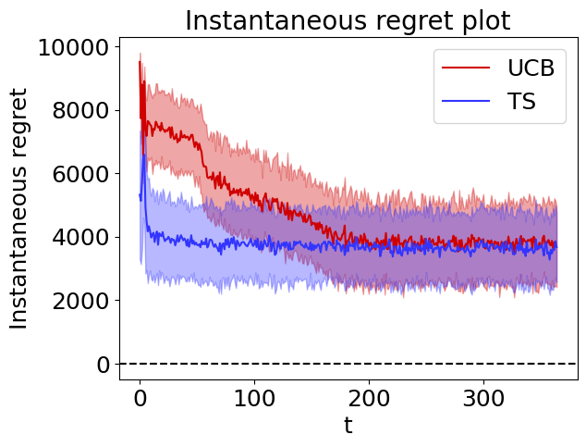
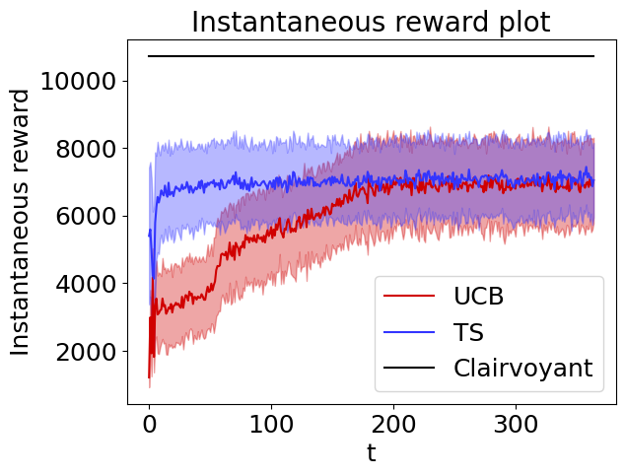
Step 4: Context generation
Results - Case 3
The following plots are obtained by averaging the results of 100 experiments.
The instantaneous regret does not tend to zero as the time grows, neither for TS nor for UCB1. The instantaneous reward and the instantaneous regret reaches a point where they are almost constant, this it the point in which the learner found the best price and bid for the setting. The single learner we are using is learning the best arms for the aggregate context that in general are sub-optimal. The reward cannot reach the instantaneous reward given by the clairvoyant algorithm in the case of disaggregate context since it doesn’t distinguish between users belonging to different classes.
Also in this case TS algorithm is faster in learning with respect to UCB1.

Slide 62
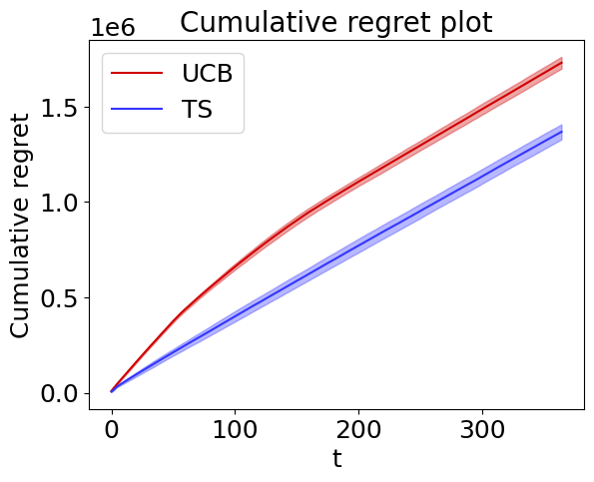
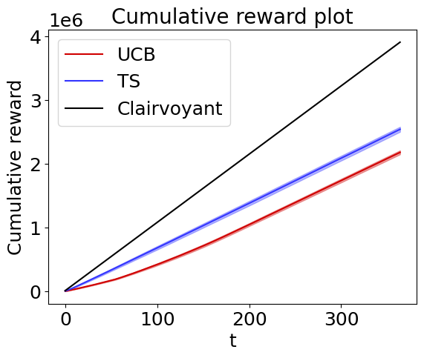
Step 4: Context generation
Results - Case 3
As expected the cumulative regret is linear for both the algorithms. This is due to the fact that the learners are pulling a single price and bid at each time and are using them for all the users of the environment. The learner, in this way, is estimating the best arms for the aggregate model that in general are not equal to all the ones of the user classes. The clairvoyant algorithm gives the optimal cumulative reward of the disaggregate model, that in general is higher than the one from the aggregate setting. It is possible to see indeed that there is a lot of difference in the two rewards. The fact that in the instantaneous regret does not tend to zero is translated in a linear shape of the cumulative regret.
Also in this case it is possible to see that TS algorithm outperforms UCB1.

Slide 63


Step 4: Context generation
Comparison cases 2 and 3
Here the comparison between the learners of the scenario 2 and 3.
Thanks to price discrimination and bid discrimination strategies the reward collected by the system that estimates the context structure of the problem is greater than the one of the system that uses a single learner, which is using the fully aggregated context.
Even if the context generation algorithm does not always determine the actual context structure, it estimates a better context structure with respect to the one that considers all the users in the same context.

Slide 64
Roadmap
Introduction
Advertising
Context generation
Frequent changes
0
1
2
3
4
5
6
Pricing
Joint Pricing and Advertising
Non-stationary
environment

Slide 65
Step 5: Non-stationary environments with two abrupt changes
Setting
In this step the pricing part is unknown, instead the advertising one is known. In this case, the pricing curves are subject to two abrupt changes. The objective is to maximize the reward across all the phases while estimating the purchase conversation rates, using variations of UCB1 to deal with non-stationary settings.
Scenario:
All the users belong to class C1
Curves related to the advertising part are known
Curves related to the pricing part are unknown and non-stationary, being subject to three different seasonal phases
Task:
Apply UCB1, UCB1 with sliding window and UCB1 with change detection test to maximize the reward while estimating the conversion probabilities
Provide a sensitivity analysis of the parameters employed in the algorithms
Plot the average value and standard deviation of the cumulative regret, cumulative reward, instantaneous regret and instantaneous reward
Compare the results of the three algorithms

Slide 66
Step 5: Non-stationary environments with two abrupt changes
Approach
In this scenario the advertising curves are fully known, thus the reward is computed using the real values of the number of clicks and cumulative cost given the bid related to the chosen price. Three different versions of UCB1 are employed to minimize the regret while learning the conversion probabilities.
The phases are spread over the year as follows:
the first phase, which lasts from February to May, is characterized by the launch of the mobile phone when the preferred price is the fourth one (650€) because customers are more eager to spend to obtain the new phone in their hands;
the second phase, that goes from June to around September, is characterized by regular purchasing period when the preferred price is the intermediate one (600€), thus there is a slight decrease in price;
the third phase lasts from October to January and it is characterized by discounts sales since it is a festive period and the launch of the next generation phone is upcoming. During this period the second price (550€) has a peak in its conversion rate.
[A3] Conversion probabilities for the three phases

Slide 67



Step 5: Non-stationary environments with two abrupt changes
Approach
The interaction between the learners and the environment is the same as step 1, namely for each price the best bid is computed and then the associated number of clicks and daily cost. Successively, the arm is pulled maximizing the reward using the learners’ estimate of the conversion probabilities. Finally, the learners are updated using the collected data.
In this step, together with standard UCB1, it is required to use two different versions of UCB1 tailored for non-stationary environments. In particular UCB1 with sliding windows (SW-UCB) and UCB1 with change detection test (CUSUM-UCB).
We followed theoretical recommendations to determine the parameters of the two variants:
in the case of sliding window, the value used for the window size is = 76
in the case of change detection the algorithm used is CUSUM. The chosen parameters are:
M = 50
𝜀 = 0.1
h = = 2.95
𝛼 = = 0.13

Slide 68


Step 5: Non-stationary environments with two abrupt changes
Results
100 experiments were carried out to create the plots.
As expected the two non-stationary versions of UCB perform better than the vanilla UCB, with CUSUM-UCB being the best one.
In particular, we can observe that SW-UCB and CUSUM-UCB, in each phase, obtain a sub-linear regret, being able to handle with non-stationary settings. UCB instead cannot, especially during the second phase where it doesn’t detect the change obtaining a linear regret. The cumulative regret of UCB increases significantly during the second phase, outpacing the regret of the other algorithms.
In the average case employing SW-UCB in comparison to UCB provides for a loss reduction from around 350k€ to 275k€ (-22%), instead using CUSUM-UCB to 200k€ (-43%).

Slide 69


Step 5: Non-stationary environments with two abrupt changes
Results
These charts show that all three learners do well during the first phase, but when the first abrupt change occurs, the two non-stationary versions of UCB are able to handle it whereas UCB is unable to. In fact, after 120 days UCB has a good estimate of the conversion probabilities and the bounds are tight so it takes a lot of time to realise that the optimal price has changed. In the third phase, CUSUM-UCB and SW-UCB also quickly identify the best arm.
Periodically, with period of the window size, SW-UCB has negative peaks in the instantaneous reward (positive peaks in instantaneous regret). This is due to the fact that suboptimal arms leave the window since they are never played, causing the corresponding bounds to explode. Therefore the algorithm is forced to play them at least once, but by receiving a low reward, it is prone to play again the optimal price.

Slide 70



Step 5: Non-stationary environments with two abrupt changes
Sensitivity Analysis - UCB-SW
We tried five different window size values for the UCB sliding window, all of them were proportional to .
Furthermore, we tested the following theoretical value (Garivier et al.^{[2]}): if the horizon T and the growth rate of the number of breakpoints are known in advance we can set the window size to .
The lower is the window size, the higher is the number of times that the algorithm has to retry all the arms. In this case, by applying small multiplicative factors, like 1 or 2, the performances decrease because the window is too short with respect to the length of the phases and so the learner frequently needs to play suboptimal arms. While the larger is the window size, the lower is the sensitivity of the algorithm.
Values for the window in the range between 50 and 80, for instance using a factor of 4, are good. Using as multiplicative factor 6 or 7 would be optimal in this case because the window size would be similar to the length of the phases. Applying even higher factors would decrease the performance leading SW-UCB to don’t explore enough.
[2] On Upper-Confidence Bound Policies for Non-Stationary Bandit Problems,Garivier, A., & Moulines, E. (2008), https://arxiv.org/pdf/0805.3415.pdf

Slide 71

Step 5: Non-stationary environments with two abrupt changes
Sensitivity Analysis - UCB-CUSUM
CUSUM - M analysis
We analyzed five different values for M, that is the number of samples used to compute the reference point, namely the empirical mean of the conversions for a given price, employed to detect changes.
Because the detection test is not run until M samples have been gathered, in general, if M is too large, the majority of the observations are utilised to compute the reference point, making the algorithm behave similarly to a regular UCB. Therefore, with big values of M, it's possible that the changes aren’t detected or take a long time to be identified.
A too small M is still suboptimal since it leads to inaccurate estimations of the reference point and more frequent change detections, even when no actual change occured.
Each arm should be played at least M times between each breakpoint, and M should be large enough to allow for an accurate estimation of the reference point. In this instance, placing M between 50 and 100 is sufficient to get a decent estimate of the reference point because each time an arm is chosen, it receives approximately 100 clicks. All of the values taken into consideration perform similarly.

Slide 72

Step 5: Non-stationary environments with two abrupt changes
Sensitivity Analysis - UCB-CUSUM
CUSUM - 𝜀 analysis
We tested five different values for 𝜀, which is used to have an underestimation of the deviation from the reference point.
In general, with low values of 𝜀, changes are detected even when there aren’t. Whereas as 𝜀 increases the sensitivity decreases, so more samples of the new distribution are necessary to flag a change.
We note that values in the range between 0.01 and 0.1 produce similar performance, while increasing the value of 𝜀 results in a rise of the cumulative regret, because 𝜀 should be of the order of the changes in the distributions, which in our case are of the order of 0.1.

Slide 73



Step 5: Non-stationary environments with two abrupt changes
Sensitivity Analysis - UCB-CUSUM
CUSUM - h analysis
We inspected five different values of h, that is the threshold over which a detection is flagged, namely a change in the conversion probabilities. As suggested in Liu et al.^{[3]} we tried values proportional to .
In general, low values of h makes the algorithm more sensitive, while high values makes it less sensitive.
With our parameters the best performing h is the one with multiplicative factor 0.5. As the factor increases the cumulative regret gets worse since the learner needs more evidence to detect a change in the distribution.
In case the number of breakpoints is known, Liu et al.^{[3]} propose to use , that would be optimal in this case as it is possible to see from the plot.
[3] A Change-Detection based Framework for Piecewise-stationary Multi-Armed Bandit Problem, Liu et al., 2017, https://arxiv.org/pdf/1711.03539.pdf

Slide 74


Step 5: Non-stationary environments with two abrupt changes
Sensitivity Analysis - UCB-CUSUM
CUSUM - 𝛼 analysis
We inspected five different values of 𝛼, that is the pure exploration parameter. As suggested in Liu et al.^{[3]} we tried values proportional to . .
𝛼 is the probability with which a random arm is played rather than the one recommended by UCB.
If 𝛼 is too low, the algorithm is suboptimal since it exploits too much, pulling almost always the suggested arm and rarely trying other arms that could became optimal in a non-stationary environment.
Instead, if 𝛼 is too large, the learner explores too much, thus it frequently pulls random arms being able to detect changes, but not exploiting what has learned.
From the plot we observe that lower values of 𝛼 give lower regret.
[3] A Change-Detection based Framework for Piecewise-stationary Multi-Armed Bandit Problem, Liu et al., 2017, https://arxiv.org/pdf/1711.03539.pdf

Slide 75
Roadmap
Introduction
Advertising
Context generation
Frequent changes
0
1
2
3
4
5
6
Pricing
Joint Pricing and Advertising
Non-stationary
environment

Slide 76
Step 6: Non-stationary environments with many abrupt changes
Setting 1
In this step the pricing part is unknown, instead the advertising one is known. In this case, the pricing curves are subject to two abrupt changes. The objective is to maximize the reward across all the phases while estimating the purchase conversation rates, using algorithms to deal with non-stationary settings.
Scenario:
All the users belong to class C1
Curves related to the advertising part are known, the bid is fixed
Curves related to the pricing part are unknown and non-stationary, being subject to three different seasonal phases
Task:
Apply UCB1, UCB1 with sliding window, UCB1 with change detection test and EXP3 to maximize the reward while estimating the conversion probabilities
Plot the average value and standard deviation of the cumulative regret, cumulative reward, instantaneous regret and instantaneous reward
[A3] Conversion probabilities for the three phases

Slide 77
Step 6: Non-stationary environments with many abrupt changes
Approach
This scenario is very similar to the one of step 5, the only differences are that also the algorithm EXP3 is implemented to deal with the non-stationary setting and that the bid is fixed (value 2.90€). Therefore it is not necessary to optimize the advertising problem and so the number of clicks and cumulative daily costs are fixed too.
EXP3 is an algorithm used for adversarial bandit settings or to deal with non-stationary settings when no information about the specific form of non-stationarity is known beforehand. It keeps one weight for each arm and selects the next arm to pull at random from the probability distribution provided by the weights. The weights are increased when the reward is good. EXP3 depends on the hyperparameter 𝛄 ∈ [0, 1] that represents the probability of playing a random arm rather than the one chosen according to the weights. The closer 𝛄 is to 1, the more the arms tend to be picked uniformly. While the closer 𝛄 is to 0, the more the arms are pulled according to the weights.

Slide 78







Step 6: Non-stationary environments with many abrupt changes
Approach
EXP3 works as follows^{[4]} :
at the beginning the weights associated to the arms are all initialized to 1;
in each round the algorithm pulls an arm at random from the probability distribution provided by the weights . The probability associated to each arm i is:
the observed reward associated to the played arm is rescaled into the interval [0,1] obtaining ;
the estimated reward is defined as ;
only the weight associated to the played arm is updated according to:
K is the number of arms
[4] https://jeremykun.com/2013/11/08/adversarial-bandits-and-the-exp3-algorithm/

Slide 79

Step 6: Non-stationary environments with many abrupt changes
Results - Setting 1
In this setting we want to compare the performances of EXP3 with UCB and its variations in the case of two abrupt changes, running 100 experiments.
As expected, the algorithm doesn’t perform well in a context where the number of abrupt changes is low.
The plot of cumulative regret shows that the regret is sub-linear only in the first phase and slightly during the third one, but in both phases the learning occurs slowly as we see from the plots of instantaneous regret and reward.
It's worth noticing that the cumulative regret of EXP3 is more than double than the regret of SW-UCB and CUSUM-UCB.
Overall, we can say that EXP3 performs poorly with respect the other algorithms tested.

Slide 80
Step 6: Non-stationary environments with many abrupt changes
Setting 2
In this step the pricing part is unknown, instead the advertising one is known. In this case, the pricing curves are subject to many abrupt changes. The objective is to maximize the reward across all the phases while estimating the purchase conversation rates, using algorithms to deal with non-stationary settings.
Scenario:
All the users belong to class C1
Curves related to the advertising part are known, the bid is fixed
Curves related to the pricing part are unknown and non-stationary, being subject to five different phases that cyclically change with a high frequency
Task:
Apply UCB1, UCB1 with sliding window, UCB1 with change detection test and EXP3 to maximize the reward while estimating the conversion probabilities
Plot the average value and standard deviation of the cumulative regret, cumulative reward, instantaneous regret and instantaneous reward
[A4] Conversion probabilities for the five phases

Slide 81
Step 6: Non-stationary environments with many abrupt changes
Approach
This setting is very similar to the previous one, with the only difference that now there are no more only three phases spread over the time horizon but instead there are five different phases, each one associated with a different optimal price, which alternate cyclically with a high frequency. The five phases have different lengths and last 16, 21, 23, 15 and 19 days, so between two or three weeks.
This adversarial setting could be caused by the presence of competitor companies that launch their smartphones or make important discounts during the year affecting the conversion probabilities of the customers of our product. In addition, during the year there are discount periods like Back to School and Cyber Monday that can cause a change in the purchase habits of the customers for just short periods.
The high non-stationary degree makes really difficult to address this scenario because the learners don’t have enough rounds to learn the best arm so they tend to play suboptimally in all phases. This is expected for UCB which is not tailored for this kind of setting.
The interaction between the learners and the environment remains the same as it was in the previous step because there is only the aforementioned difference.

Slide 82

Step 6: Non-stationary environments with many abrupt changes
Results - setting 2
Also in this case we did 100 experiments to obtain the plots.
It is clear that none of the algorithms can deal with this environment, since all achieve a linear regret. With a cumulative regret of over 100 thousand € compared to the others, EXP3 is by far the worst of the four.
The two non stationary variants of UCB perform worse than UCB itself, which results to be the best one.
We tried also different values for 𝛄, but the outcome doesn’t improve. Two variations between our implementation and the original algorithm may be the cause of EXP3's poor performance:
we rescale the profit in [0, 1] for each observation, but as there are only five distinct prices and hence only five unique profits, then there are only five possible values as output of this normalization;
at each round the learner receive around 100 observations and for each one the associated weight is updated, so there is the risk that this weight will increase significantly relative to the others.

Slide 83



Slide 84
References
[1] Gaussian Process Optimization in the Bandit Setting: No Regret and Experimental Design, Srinivas et al. (2010), https://arxiv.org/pdf/0912.3995.pdf
[2] On Upper-Confidence Bound Policies for Non-Stationary Bandit Problems,Garivier, A., & Moulines, E. (2008), https://arxiv.org/pdf/0805.3415.pdf
[3] A Change-Detection based Framework for Piecewise-stationary Multi-Armed Bandit Problem, Liu et al., 2017, https://arxiv.org/pdf/1711.03539.pdf
[4] https://jeremykun.com/2013/11/08/adversarial-bandits-and-the-exp3-algorithm/

Slide 85
Appendix - A1
[A1] Here it follows the precise numbers used for the conversion probabilities of the three classes for step 1 to 4:
Conversion Probabilities per class
Class \ Price (€) | 500 | 550 | 600 | 650 | 700
C1 | 0.10 | 0.12 | 0.20 | 0.04 | 0.03
C2 | 0.03 | 0.04 | 0.10 | 0.12 | 0.20
C3 | 0.20 | 0.12 | 0.10 | 0.04 | 0.03
Steps 5 and 6 require a detailed analysis on non-stationary settings for a single class, thus these values change. View the relevant appendices.

Slide 86
Appendix - A2
[A2] Here the equations used to plot the clicks and costs curves:
Clicks
Class \ Parameters | Scale | Slope
C1 | 100 | 3
C2 | 90 | 1
C3 | 70 | 0.5
Cumulative daily costs
Class \ Parameters | Scale | Slope
C1 | 35 | 1
C2 | 25 | 0.5
C3 | 15 | 0.2

Slide 87
Appendix - A3
[A3] Here it follows the precise numbers used for the conversion probabilities of the three phases for step 5 and step 6 case 1:
Conversion Probabilities per phase
Phase \ Price (€) | 500 | 550 | 600 | 650 | 700
Phase1 | 0.07 | 0.10 | 0.10 | 0.20 | 0.10
Phase2 | 0.08 | 0.06 | 0.12 | 0.03 | 0.03
Phase3 | 0.18 | 0.30 | 0.15 | 0.02 | 0.02

Slide 88
Appendix - A4
[A4] Here it follows the precise numbers used for the conversion probabilities of the five phases for step 6 case 2:
Conversion Probabilities per phase
Phase \ Price (€) | 500 | 550 | 600 | 650 | 700
Phase1 | 0.07 | 0.10 | 0.10 | 0.20 | 0.10
Phase2 | 0.08 | 0.06 | 0.12 | 0.03 | 0.03
Phase3 | 0.18 | 0.30 | 0.15 | 0.02 | 0.02
Phase4 | 0.27 | 0.12 | 0.06 | 0.02 | 0.01
Phase5 | 0.09 | 0.06 | 0.12 | 0.10 | 0.13

